Slide 1
Short film pitch
Chloe- producer
Kayley- director
Callum- sound
Esther- lighting
Kacper- camera op

Slide 2
Storyline
-Inspiration: Inspired by a character from the game Dead By Daylight
detective who is also a serial killer
-Our story: Tv show host who is also a serial killer who uses the murders he committed as content for his TV show. Interviews the families of his victims
-Nolan aspects: Use of muted colours and urban environments as well as a potential 1950’s aesthetic/film noir.

Slide 3

BBFC RATING
15a certificate is a rating given by the BBFC that determines that a particular form of media is suitable only for older teens aged 15 or over. There will be use of some strong language and themes of violence like: murder scenes and heavy blood use

Slide 4
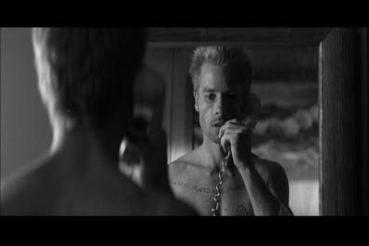
Auteur stylings
Our film will mimic Nolan’s style through the common use of the psychological theme, as our narrative is based around a character with psychological issues.
Many of Nolan’s characters demonstrate duality, like batman, who doubles as a rich playboy and a masked vigilante. Our main character will demonstrate duality as he will use his role as a TV show host as a cover up for his dark side, as he goes out and kills people.
Nolan also uses low key lighting, which we will include during the murder scenes, in locations such as alleyways and dark areas.
We aim to use camera shots that Nolan also uses, like 360 shots and mirror shots, as these will help us show the twisted mind of our main character.

Slide 5
Costumes & Props
Costumes
Suit/Formal Clothing
Fake Mustache
Props
Mask but we are waiting for the results from our questionnaire
Fake Blood
Time appropriate weaponry (switchblades/vintage knife) awaiting responses
-Zippo lighters

Slide 6
Music and sound
​
Nolan films include music that mimics the emotions of the characters in a scene, like synthesized songs that represent a heart-racing/beating. https://www.youtube.com/watch?v=3LEJGxXzuAE
We could use this type of music in our film for the murder scenes, to show the panic of the victims before they are killed.
We could also use distorted sounds/music during the scenes where we focus on the serial killer when he is by himself, not on his talk show and not killing, just left with his own thoughts.
We will have also add the sound effect of audience members clapping during the talk show to show that there are audience members without having to actually film them.
Other sound effects could include screams and sounds of a knife piercing into the victims.

Slide 7
Target Audience
We are targeting explores as these are younger demographics target audiences who seek adventure and excitement so our story line could provide this. They would be class E as they would be unemployed/students.
We can also reach older target audience as our film has aspects of film noire. Which is a genre that older audiences will be familiar with. These older audiences would fit into the resigned section as they seek security and familiarity.

Slide 8
If things go wrong
If our actors don’t show up, we will need back up actors so we can still film.
If it is raining we will try and reschedule a different day and swap different locations around.
If there are any technical difficulties, we will refilm.

Slide 9
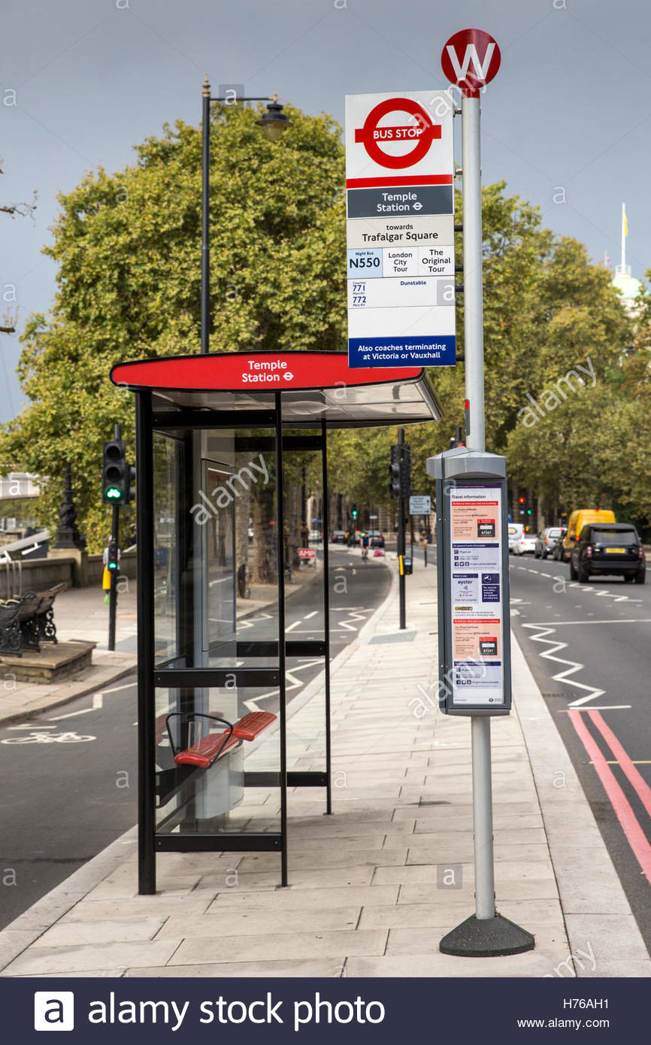
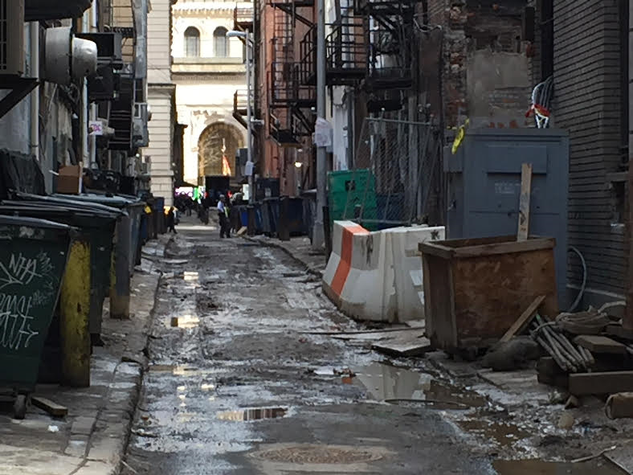
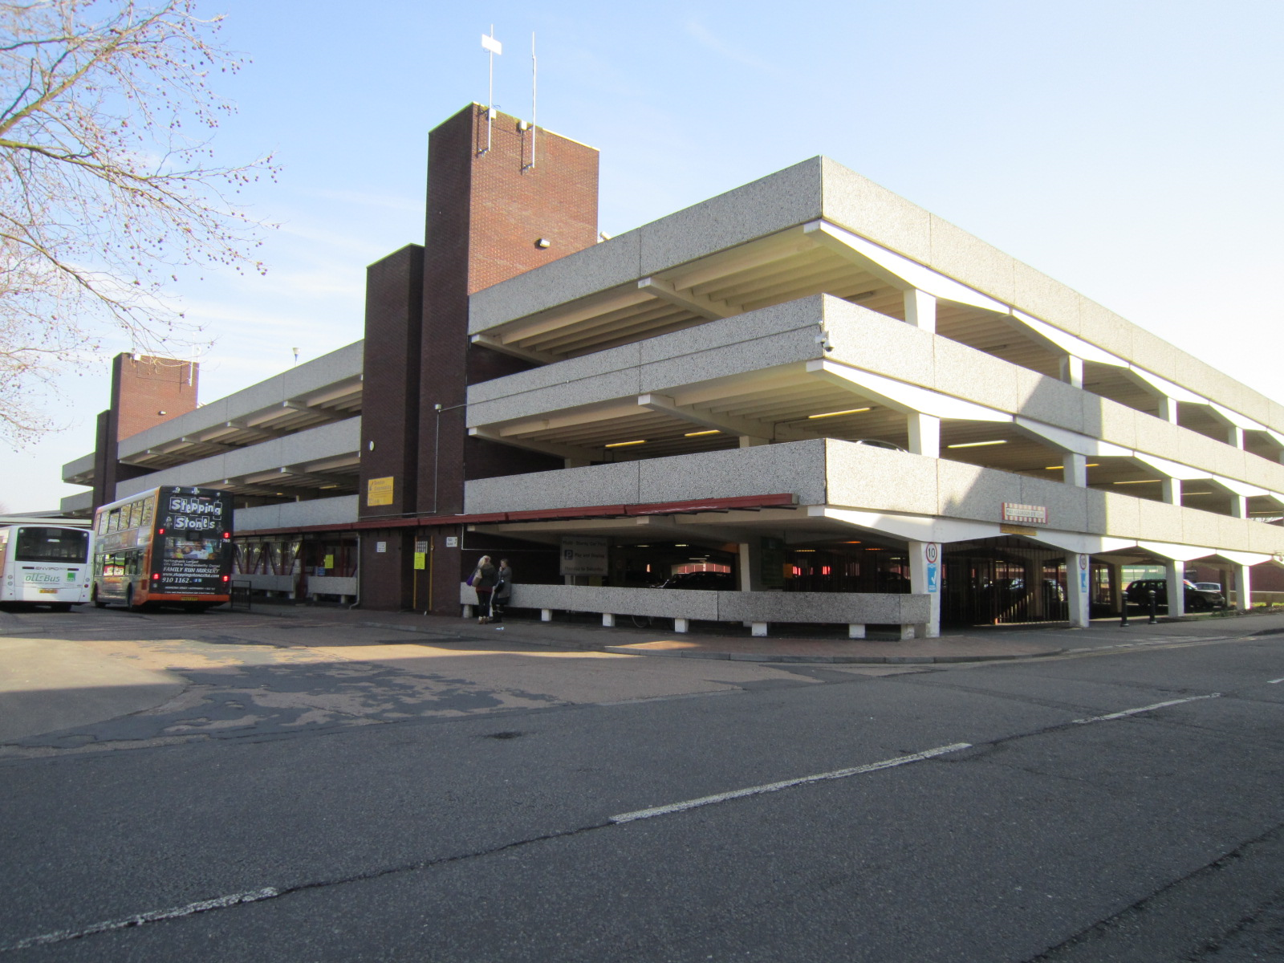
Locations
The locations we will need to film our short film is the TV studio so that we can film the TV show host. We will need alleyways to create the death scene. We will also need to film at the stairs in college. We will need a bus stop so we can create the scene where the killer is going to murder the victim. We need to use the multi car park at the mall so we can create the running scene.

Slide 10
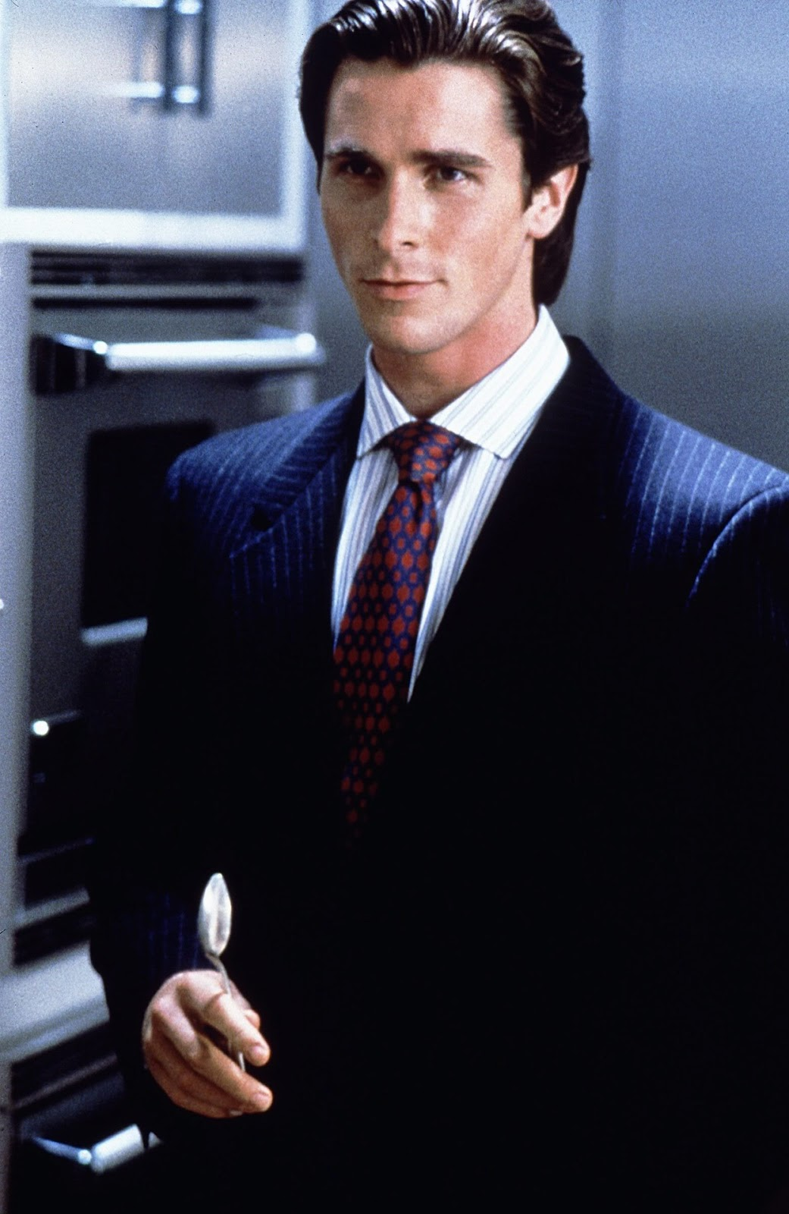
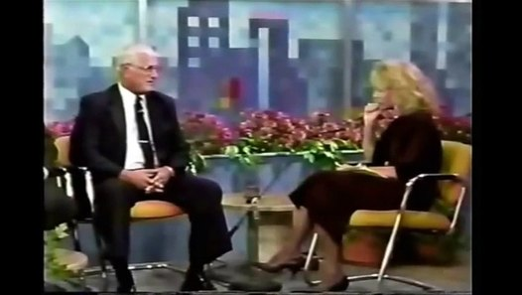
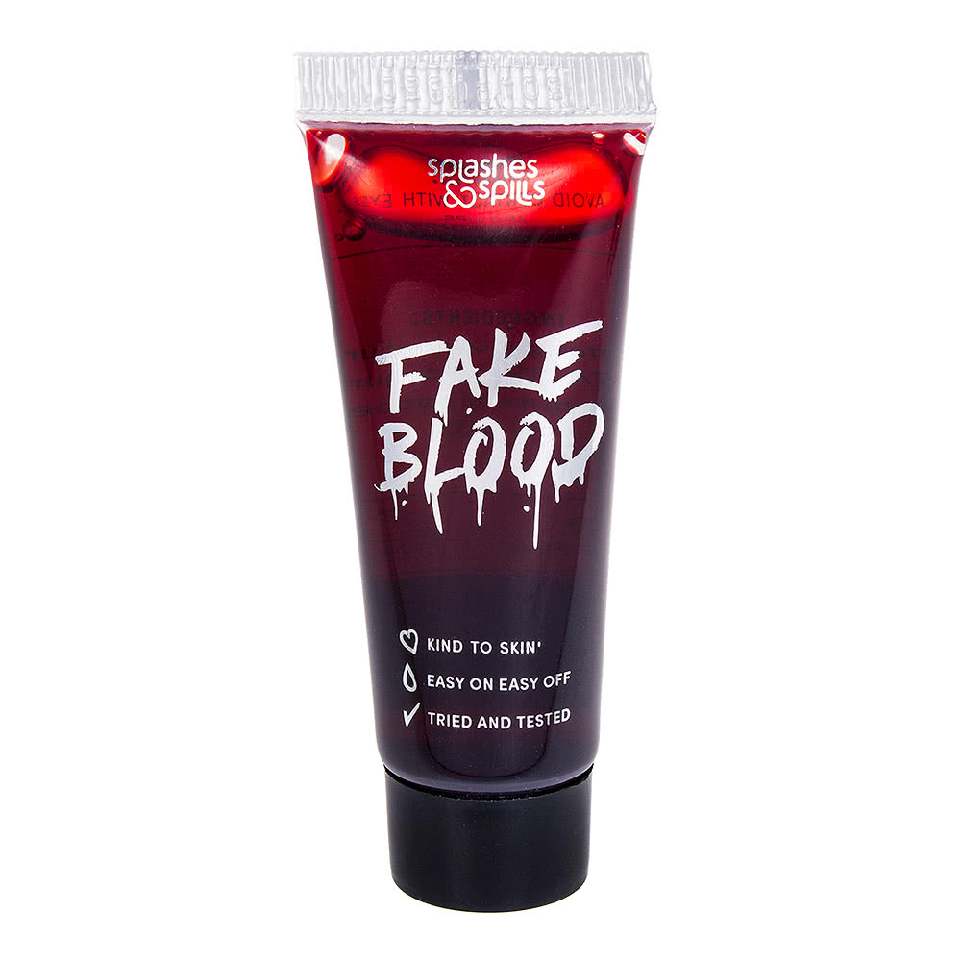
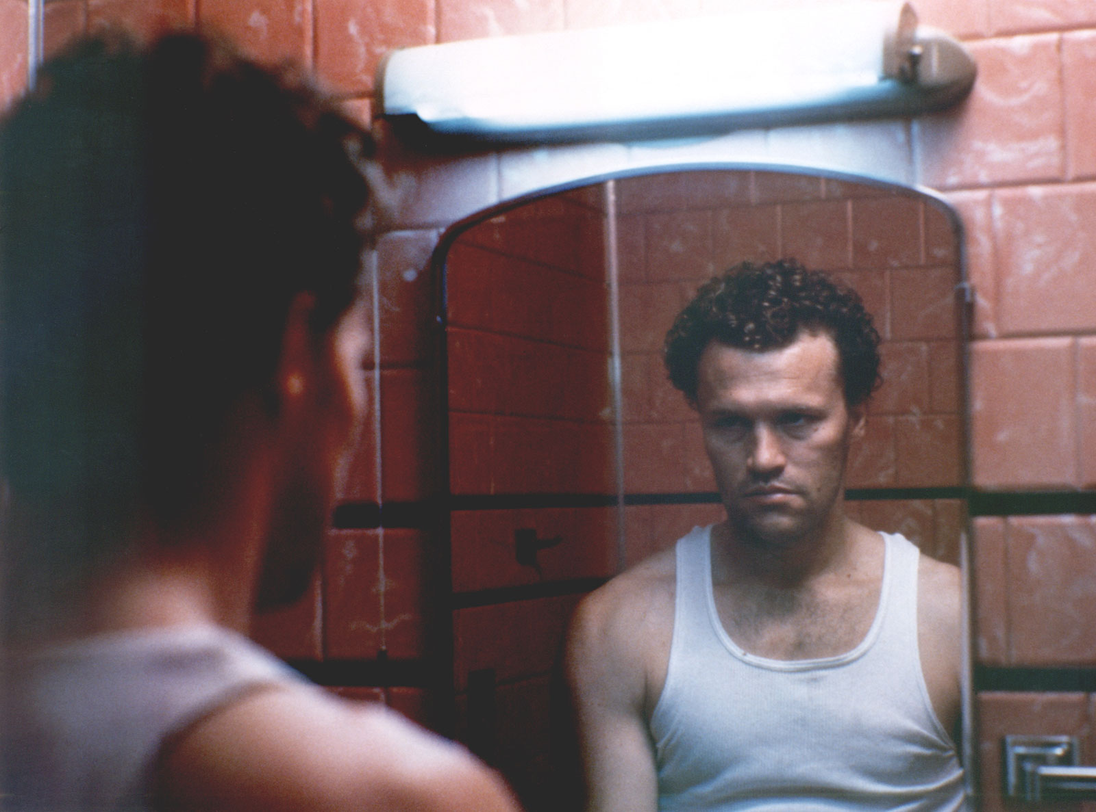
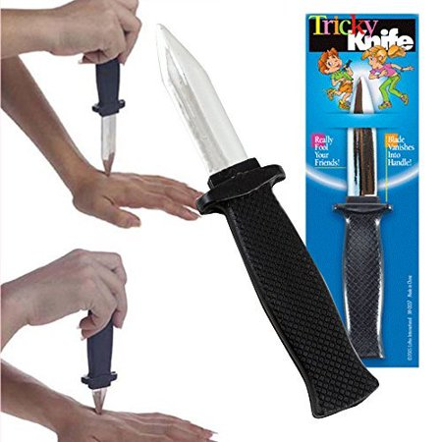
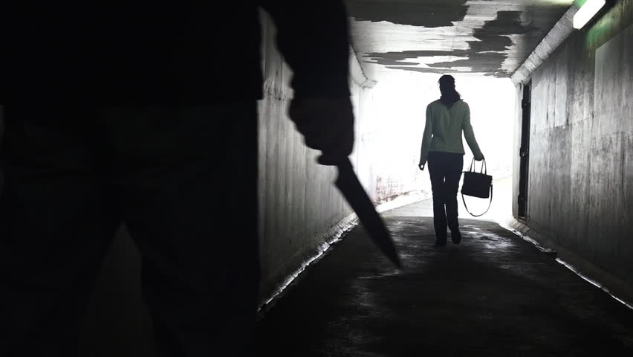
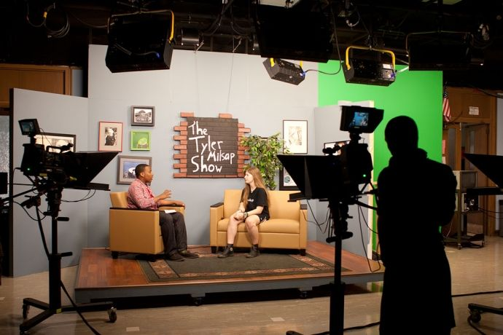
Mood board
https://www.youtube.com/watch?v=osxjp4Z4oLE
https://www.youtube.com/watch?v=K4wPHPX9fhU
https://www.youtube.com/watch?v=zVY8PaRF1jE

