Slide 1
Point Heist
Shamaim- Director
James- Host
Callum- Camera Op
Kayley- Camera op
Esther- Camera op
Kacper- Lighting/sound

Slide 2
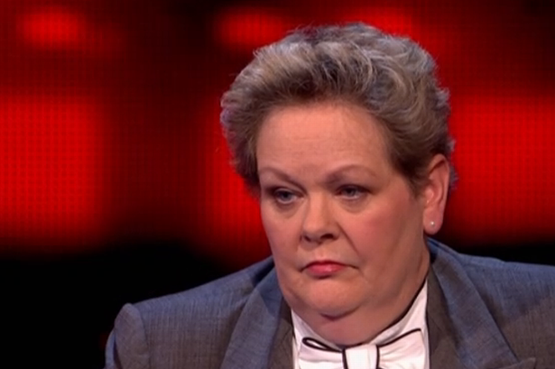
Inspiration
When analysing other existing game shows, we were able to gain ideas for our own show.
The chase gave us the idea to have some of our contestants be ‘raining champions’ who go against a new set of contestants.
It also gave us the idea to have our host poke fun at the contestants to make the show more entertaining.
We were also inspired by the family feud set design, which consists of 2 teams on opposite sides, with the host in the middle.

Slide 3
Sub Genre
We are creating a hybrid that is between quiz and a panel game show.
We said panel because we are having teams that are competing against each other.
Quiz as well because we asking the contestants questions from different categories this is to test their knowledge

Slide 4

The title of the show
We chose this title of the show because our show idea consists of two teams competing in the show and stealing points off each other in order to win and that's where the name of Point Heist came from. So the title of our game show is Point Heist.

Slide 5
How will our show be original?
Our show will be original as it includes our audience getting involved with them having to write three words on a piece of paper to describe a movie and the contestant will have to guess the movie using the three words that are written down.
Our game show will also include a Russian host who will take digs at the contestants throughout the show.

Slide 6

Mechanics:
How will the Show work?: There will be a total of 6 participants in the show who will engage in various activities ranging from guessing geographical locations to Spinning the wheel of fate.
(3 min 30)Round 1:Pop Culture question + guess the celeb (each participant has 30 seconds to a total of 3 mins)
(2 min 30) Round 2:Sports activities and questions (answer questions while doing something physical)
(2 min 30)Round 3:GUESS THE FLAG
(Guess the flag: Participants will be challenged on their geographical knowledge and will be tasked with guessing either the capital city of a place or guess what flag represents what country.)
2 min 30)Round 4:Pictionary on white board
(2 min 30) Round 5 :Guess the movie
(2 min 30) Bonus (TBD):Spin the Wheel!
Participants will be handed a bucket from which they will pick out a random ticket.
This ticket will perhaps boost their points or retract them.It can also make them spin the wheel.
Incase noone has a spin the wheel ticket, the participant with the most points will be asked to participate either way

Slide 7


Target Audience
The target audience for our game show is:
Primary Audience-
Male and Female
16 to 22 year old
Mainstream
Class E (Students)
Secondary Audience-
Male and Female
23 to 30 year old
Aspirer
Class D / Class C2 (working)

Slide 8

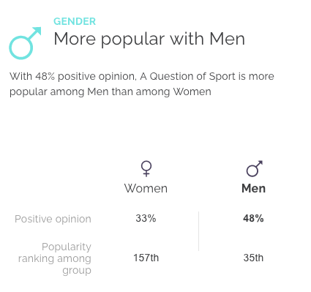
Scheduling Time and channel
The channel of our game show is BBC and the timing of the show is 7:30PM. Our show is similar to question of sport as it doesn’t really have any adult content. Similar to Question of sport,it would be more popular with men.

Slide 9
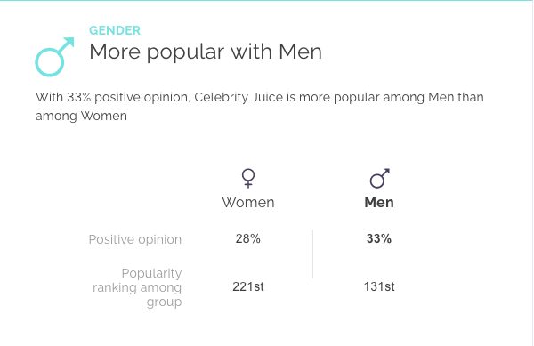

The Host.
The host will be male and will be dressed in normal clothing and will have a Russian accent, we decided on Russian as we believe that it will bring a comedy factor to the show and will be entertaining to listen to, the host will talk informally. I looked at other game show hosts that put on a persona such as keith lemon and how he entertains the audience, and the gender that watches the show the most is male so that’s the reason for a male host.

Slide 10

Contestants
The contestants for our game show are:
The contestants that we are using are last week winners against a new team from this week.
The teams are 3 VS 3. The teams are mixed so female and male.
The type of people that we are looking for are a group of friends, bubbly characters with a good general knowledge.

Slide 11

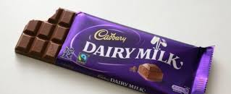
Prizes
We decided that we are going to give the team that wins a medal and a bar of chocolate.
We are going to get the medal from amazon and the bar of chocolate from a local store.

Slide 12
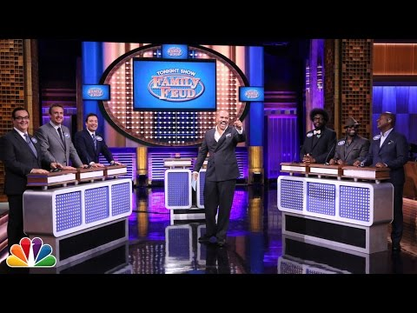

Set design
We will have 2 teams with 3 people in them.
We will need to source 2 tables to act as panels, which we will place each team on.
These tables will be put on opposite sides, with the host on a podium in the middle.
We will decorate the set with different props which help reflect a theme. For example, we will be hanging football tops on the walls to reflect the fact that we have a sport round.
We will also be sticking question marks to reflect the fact that it is a quiz show, as well as different celebrities faces as we have a pop culture round.
We will also be using purple and pink gels for lighting, as we want our set to be colourful and fun. David will be helping us source these.
We are also going to be having the audience sat in front of a green screen, which will have our graphic/logo on it, which we will add into during post production.

Slide 13
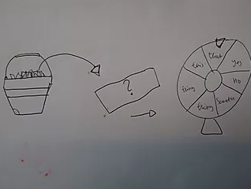
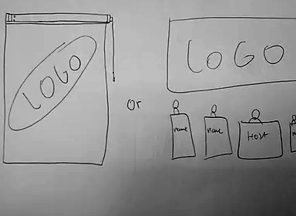
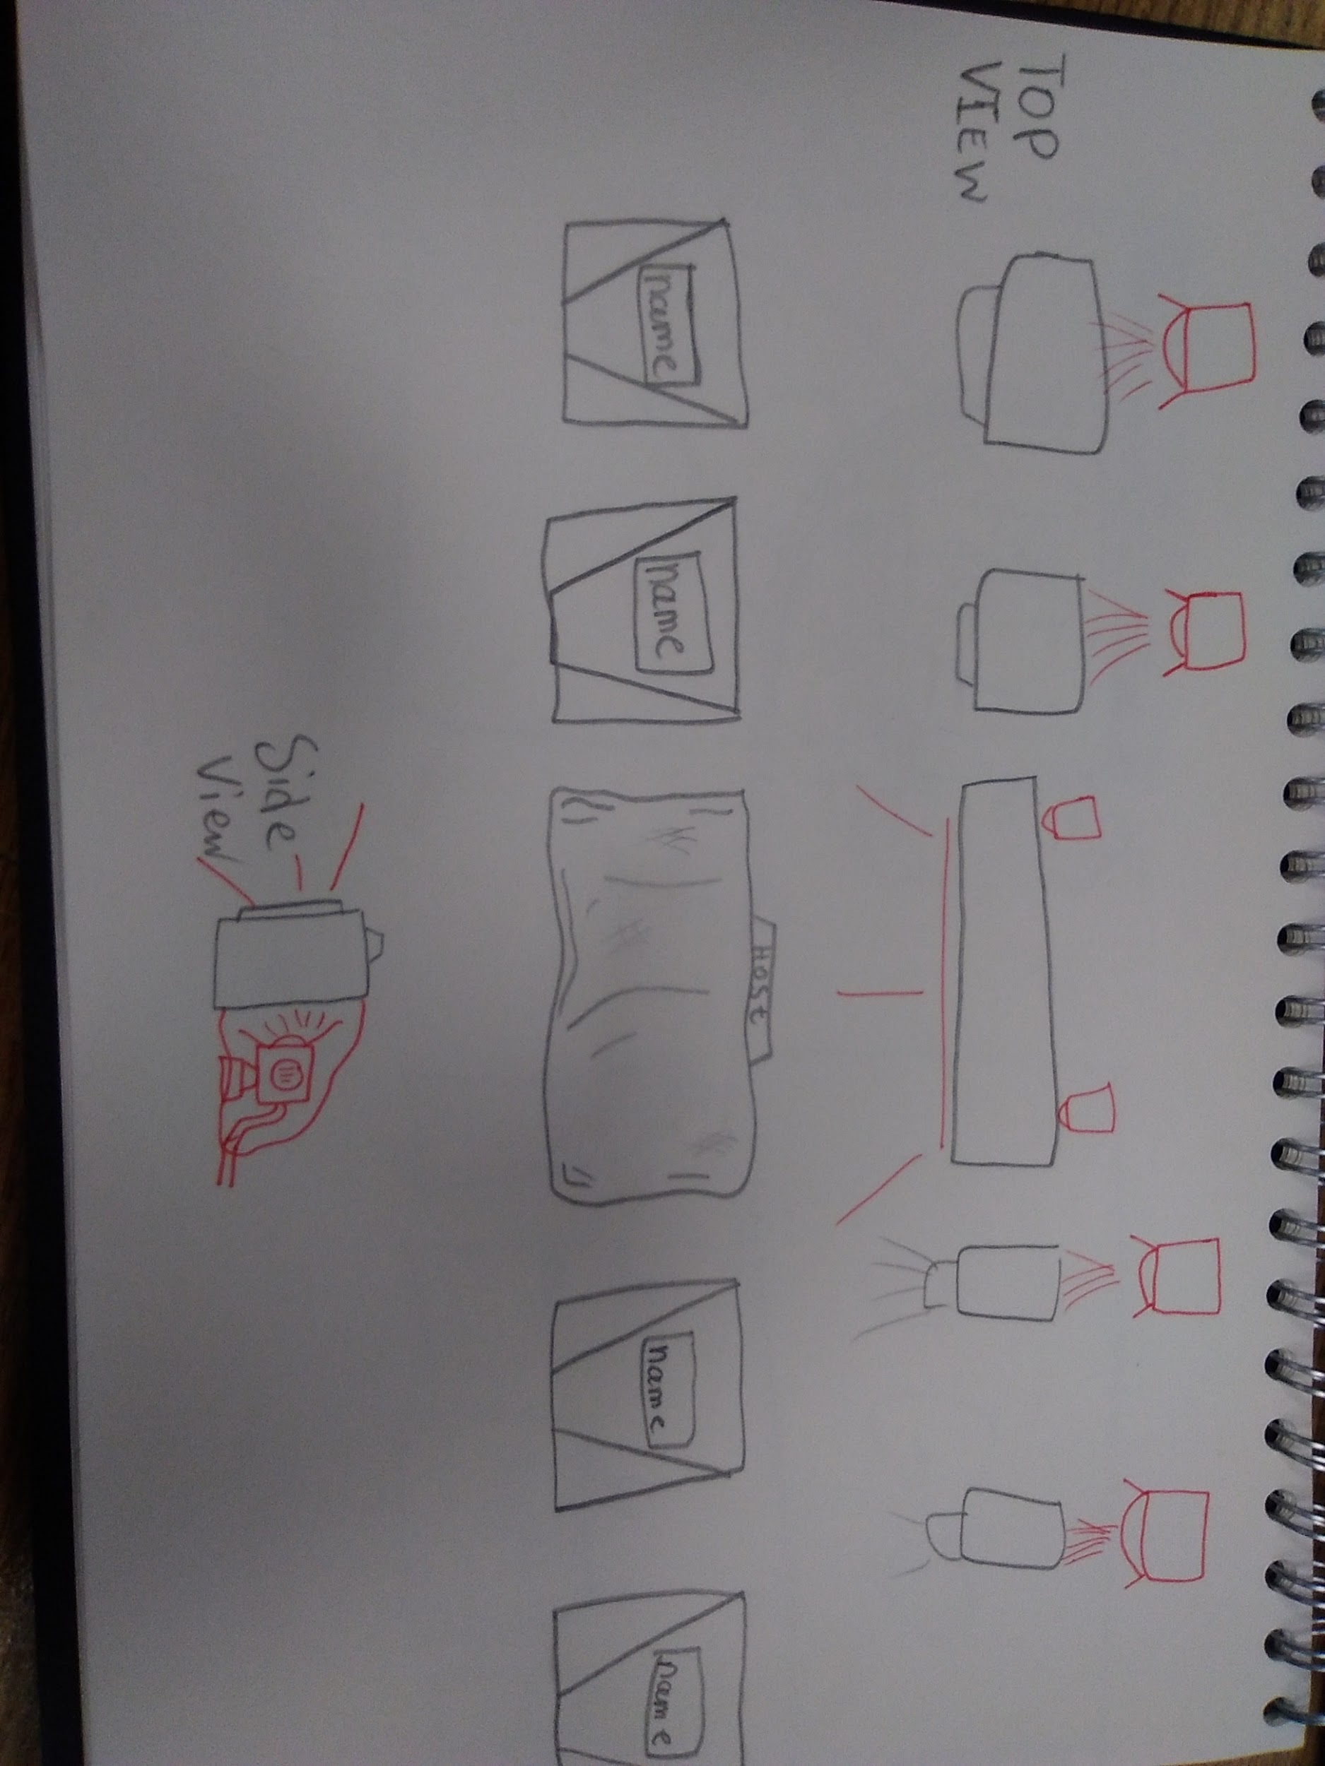
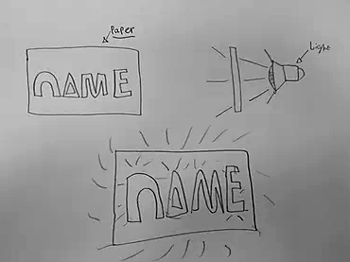
SET/MONTAGE
https://drive.google.com/open?id=1khhSBRitQykES8_iCXFRMB1ArOwcQc9h
Logo layouts:
Here are 2 types of logos inclusions
One for the host on stage and one for participants
Spin the Wheel:
Taking a ticket from a bucket that will
Prompt a participant to spin the wheel or not depending on the ticket
Layout:
This will be the ideal
Layout and lighting setup for our game show.
Lighting for names:
An idea/Concept for
Lighting up the names on the guest podiums.
Shining a light from behind a piece of paper

