Slide 1
Debate

Slide 2
Debate topic
The debate topic I chose for my debate is “how has social media impacted journalism?
When deciding on the topic for my debate I was not sure what I was going to do so I started to think about what media sectors I enjoy which is journalism. I then went on to think about what social media in journalism. I then went to combine both journalism and social media in to a question for my debate.
I chose this topic for my debate because I enjoy social media and journalism. I wanted to gain more knowledge about the impact of social media in journalism

Slide 3
Methods of primary research
For my primary research I conducted two primary research methods.
My first primary research method I conducted an interview which was qualitative research because I was getting someone's opinion on my topic .
I also conducted a questionnaire for my primary research. I chose quantitative for this part of my research as I am collecting data of people's opinion

Slide 4
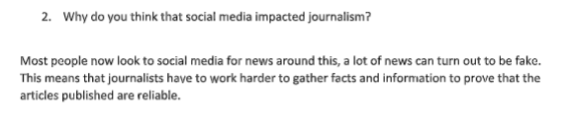
Interview
For my interview I emailed a lady named Erin who is a university student but as well as a freelancer in journalism. I sent her the questions and she sent it the questions back and I read through them. I wanted to find out more information on my debate topic.
In the image beside I asked her why does she think social media impacted journalism and she answered that people turn to social media and that some of the news can be fake. She also said that journalist have to be work harder to get the information they need.

Slide 5
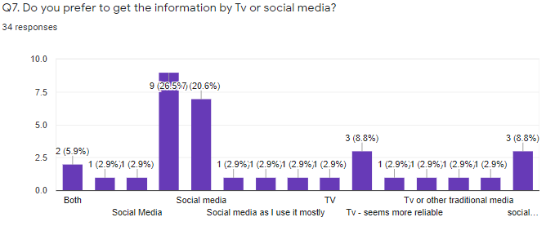
Questionnaire
I created a questionnaire as part of my primary research. The reason I created questionnaire was to find out why people like to receive their news by social media. I got 35 responses
I distributed my questionnaire on my social media pages like facebook, instagram, twitter and snapchat. I posted it on reddit. The questionnaire taught me that people do like to get there information by social media than TV as it faster and it can be shared.

Slide 6
Methods of secondary research
For my secondary research I chose qualitative research because I was researching into different topics like:
The ethics of journalism
The effect of social media in journalism
The advantages and disadvantages of social media
The role of social media in journalism
Does journalist need social media
The influence of social media in journalism
Does journalist have access to the audience through social media

Slide 7
What my secondary research taught me
My secondary taught me many different things:
One of the things that I have learnt is that fake news is disadvantage in journalism as it can confuse people or make people believe that the fake news real.
Having social media in journalism has many positives because it is faster, they can share the information.
Social media allows the journalist to have access to more information like finding out facts and contacting people. They can also engage with the audience on social media.
I have learnt many more things like the different ethics of journalism and social media.

Slide 8
The link and gap in my knowledge
The link between both my primary research and secondary research is that I was able to research different things but also get people opinion on what I was asking them. The results I got from both my primary research and my secondary was similar because most of the answers I got was that social media is faster, accessible and can be shared between people.
Looking back on my research I figured out that I do have gaps on my knowledge that I should have looked into why journalist depend on social media in my research so that I was able to gain more knowledge about the social media aspect of it.

