Slide 1
Our Pitch

Slide 2

My Role Callum Bates
My role in this production team is camera and i am in control of the camera and what kind of shots we will need to take. I am the only camera operating person in the group.
My responsibility is making sure the shots are suitable for the scenes we will be filming and making sure the camera arrives back in one piece.

Slide 3
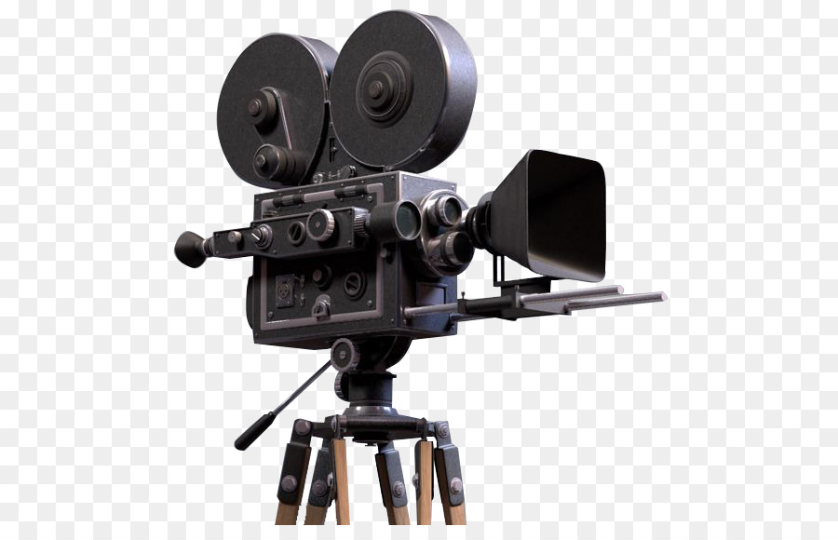
My role Esther stephenson
My role is in this unit is product assistant this means that I am there to support them by making sure we are organised. I will help with setting up the equipment and using the equipment . I also help out with everything else like recording if anyone needs help or if anyone needs assistance with putting away the equipment.

Slide 4
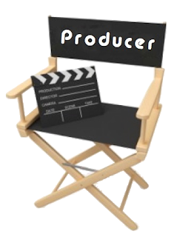
My Role Shamiam Arif
I'm the initial contact for the project. so this means that i am the leader of the whole project and what i have to say my group member will need to listen to me. I will be the one talking to the client and making sure that everything is arrange for the day of filming, it is also my job to assemble the team that going to help me with music video.

Slide 5

My Role Jubiair Ahmed
My role is to be a director the director role is to be in charge of my group and make sure they get all of the work done because I am in charge of making sure they complete everything and make sure they are enjoying themselves. I also help them with recording and do everything else that everyone does.

Slide 6
Type of music video
The type of music video we are doing is a hybrid it is between narrative and performance. We have selected this type of music video because its just dance then it is not going to go good because we need really good dancers and it's going to be very difficult to get dancers so we are doing narrative to make it more interesting and more entertaining.

Slide 7
Inspirations
The inspirations we got was from the original music video and we thought about what narrative could fit the lyrics of the original song. The narrative suits the lyrics pretty well because it is a love song and we used this idea because it’s something that just came from the top of our heads and we thought it was a good idea.

Slide 8
Identifying our idea
We all voted for the song “When Love Takes Over” by David Guetta.
So the Narrative for our music video is there is two people ( a girl and a boy) following in love however, while they were dating their friends didn’t approve of the relationship so they secretly dating without the friends knowing. Near the end, the couple go to a party have the time of their lives and the friends see how happy they are and just approve of their relationship.

Slide 9
Codes and Conventions
Some of the codes and conventions that will be used in our music video are the following such as: Bright colours, choreography, split scenes, non diegetic sound, low angles, pans, tilts and green screen.

Slide 10
Discuss how your idea relates to your research?
We research the code and conventions multi screen and lip sync. We said that we could multi screen to show different locations or different scenes. We also said lip syncing because it gives an effect that the singer is actually singing. The song when love takes over by David Guetta. We researched the song and what it was about. We got the idea that it was about a relationship. The song genre is dance. We have chose to do a hybrid because it is a crossover between a narrative and a performance as the music video tells a story but is a performance of the artist. David Guetta is the artist of the song but he is known for being a dj. Kelly Rowland is a featuring artist but you see her throughout the whole video.

Slide 11
Target Audience
The target audience for our dance music video is the following, the age is 18-25 and that is because most of the people you took our questionnaire were around that age.The gender will be both males and females because our questionnaires were very mixed.

Slide 12
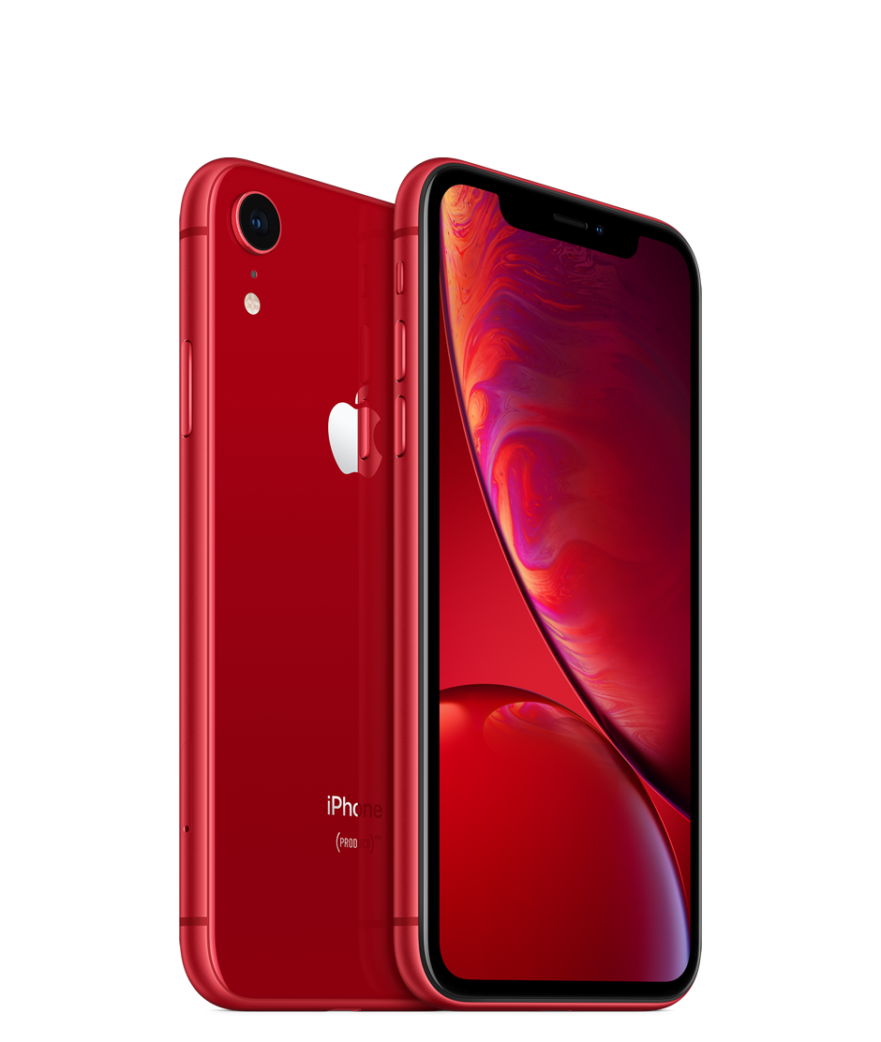
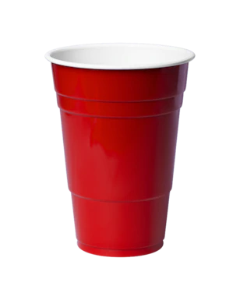
Resources
The props we will be using are the following such as: Two Phones, Makeup and paper cups, we need two phones because there is two people texting each other and we need makeup for the girls in the party scene so they look professional and we need paper cups for the party scene at the end of the music video.

Slide 13
Technical Requirements
These are the equipment that we will be needed for our music video;
Two Tripods
Two Camera
LND Lights
Mic/ Mic pole (Road Mic)
We will be using the TV studio because we will be using the green screen for a couple of our scenes. The equipment that we will be needed in the TV Studio is;
LND lights
The Lights on the ceiling
The Green Screen
Tripod that have wheels

Slide 14
Schedule
Recording at the park
Monday 8:30 - 12:15 after lunch 13:15 - 16:15 breaks every hour and a half if needed.
Recording outside college and classroom
Wednesday 8:30 - 12:15 after lunch maths then at 14:45 - 16:15 breaks every hour and a half if needed.
Recording Inside college and starbucks
Thursday 8:30 collect equipment start recording after english 10:45-12:45 after lunch 13:15 - 16:15 breaks every half and hour if needed.
Friday retakes available after 10:45-12:15 after lunch 13:15 - 16:15 breaks every half and hour if needed.

Slide 15
Technical and production issues and how you will overcome these
If we have any issues like if its raining or anything is wrong we have a backup for that day so if it's raining on monday and wednesday schedule it's not going to rain we are going to switch the days round or on Friday we can record if we need to.

