Slide 1
Cooking magazine pitch
Esther Stephenson

Slide 2
How I feel about FMP?
For this unit I am excited but I am also nervous.
The reason for me feeling this way is because I want create a magazine that stands out and showcase my knowledge and skills that I gained over the years studying media.
I also feel that this will challenge me to push myself out of my comfort zone.
I am eager to learn about InDesign as it is a new software for me and food photography.

Slide 3
My initial ideas were and what the mind map taught me.
My initial idea was to create a magazine that was for teen moms but then I had a discussion about my idea and I found out that it would be harder than I thought to create as I am not in the target audience.
Then I went to my second idea which is the cooking magazine. The reason why I chose a cooking magazine because everyone enjoys food and it is a popular topic.
The mind map has taught me that I have gained a range of skills that I need to work on more.
It made me realise that I enjoy enjoy creating magazines more than filming or editing films or music videos.

Slide 4
My final idea
My final idea is to create a cooking magazine.
In my magazine I will include food recipe, cooking tips, recipes from different countries, popular food trends, shopping lists of the ingredients and the interview I conducted.
I first came up with the name Grillzilla at first but then I got feedback on the name and the feedback was that the name should be different so I opened a poll and the most popular name is Esther Eats
I am cooking the recipes myself and taking the images.
I decided to print my magazine due to because people can give it there full attention.

Slide 5
Feedback and Evaluation
When creating my magazine I will get audience feedback.
For audience feedback I will reach out to different people that is in my target audience to get feedback
I will also use the different forums online for example reddit.
While creating the different stages of my magazine and my images I will send them out and get feedback on what I can improve on.
Throughout the production and post-production I will evaluate what I have been doing and what I can improve.
At the end of the unit I will do an overall evaluation.

Slide 6
How this FMP will stretch me and challenge me
Ths FMP will challenge me because I have not done food photography or used InDesign before.
I will be doing food photography which is different to me so I will be having a practical with Michael on it but I also have done some research on it.
I will be using InDesign to put my magazine together but I will have a practical on InDesign that will be done in the future.

Slide 7
Research methods
For my research I did both primary and secondary that included qualitative and quantitative.
For my primary research I conducted a questionnaire, a poll and an interview.
For the questionnaire I got 38 responses.
The questionnaire confirmed my idea for my magazine.
For my interview I asked a chef that works in the catering department to interview him .
The poll was mainly to help me decide on a name for my magazine.
For my secondary research I went to look at different topics that relate to my idea.

Slide 8
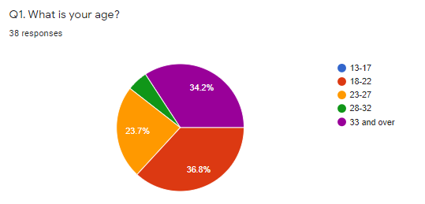
Questionnaire
From my questionnaire I found out that those who are between the ages 18-22 and those who are 33 and over answered my questionnaire the most. My primary target audience answered my question more than my secondary target audience so this made me think that I might have to change my secondary target audience. I decided that I will keep my secondary target audience the same I will find it easier to create content for them.

Slide 9
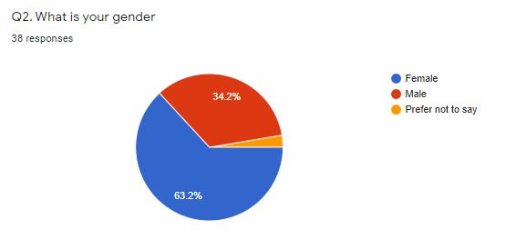
Questionnaire
From my questionnaire I found out that females answered my questionnaire more than males did. This helped me to determine that I should aim my magazine mainly at females as they enjoy cooking more than males do.

Slide 10
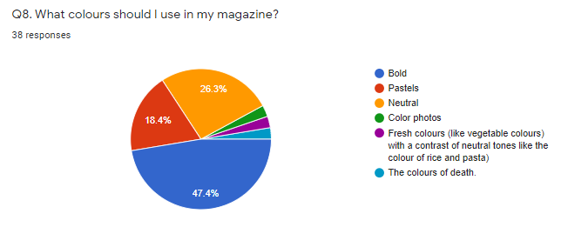
Questionnaire
I was not sure about what colours I should use for my magazine and from the responses I got bold and neutral colours was the most selected option. I have decided that I am going to use mainly neutral but add bold colours to the magazine so that my magazine looks appealing.

Slide 11
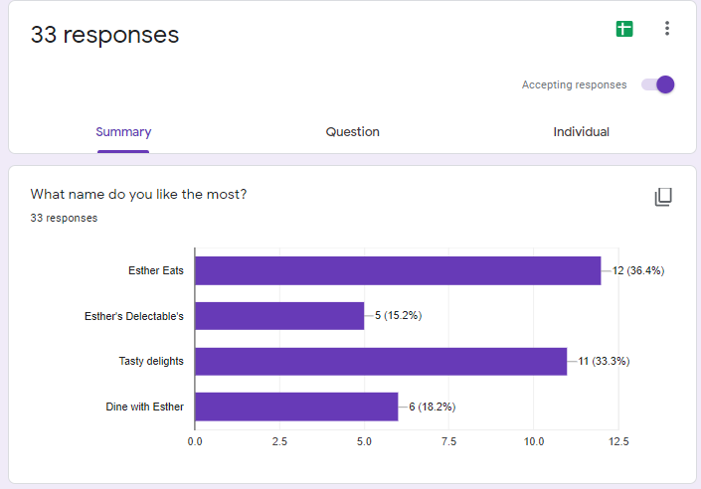
Poll
At first I chose the name Grillzilla but I wanted to change it so then I decided to do a poll. With my poll I picked four names and one of the most popular names that I chose was Esther Eats. The name is a great name for my magazine because it is short, catchy and it is personal.

Slide 12
Interview
For my interview I interviewed Darren Searle from the catering department.
In the interview I asked different questions that relates to being a chef.
I asked him questions like why did he want to be a chef, what dish does he like to cook and more.
When he respond to one of the questions he would respond to the next question.
The response he gave me was detailed and it gave me an insight into his story.

Slide 13
Secondary Research
I researched a range of topics that relates my idea.
I researched into writing articles because I feel that I can improve on my writing skills.
I looked into designing a cooking magazine. I learnt about the ABC rule I feel that this will help my magazine more.
I also looked at food photography tips and tricks that I can use for when I am taking them photos.
I looked at different InDesign tutorials that will help me
I watched different tutorials for photoshop that relates to food photography.
I looked at the demographics, psychometrics and mosaic for my target audience
I looked at recipes and recipes from different countries that I can include in my magazine.

Slide 14
Pre-production process
For pre-production I will complete different things.
I will complete paperwork for example font justification, Location sheets, risk assessment, Colour swatches and page layout.
I will also need to book the equipment that I would need.
To prepare for production I will go shopping to get all the ingredients I need to make the different recipes.
I will continue to do research.

Slide 15
Production process
I will make the recipes that I chose to include in my magazine.
I will need to take the photos using the skills and knowledge I have learnt
To take the photos I will need to stage the background of the image so that the image is presented nicely.
The equipment I would need is a tripod and a camera.
I will continue to do research.

Slide 16
Post-production process
I will need to edit the photos and the magazine in photoshop
As Indesign is new to me I will have a practical on it that will be confirmed on a later date.
In InDesign I will need to put my magazine pages together.
I will also do research to further my knowledge

Slide 17
Target audience
My primary target audience is from the ages of 18- 25 who is mainly females. They would be student who is either studying at university or at college. So they would be living at home or living at there university accommodation.
BO8 because they would be depending on their parents to support them financially. O66 because they could could be living close to there university. O65 they could have a job and be studying at the same time.
My primary target audience could be in any type of relationship for example the could be dating, single or broken up. The demographics that my I would put my primary target audience in is D and E because they are students that would have a job.
My primary target audience falls under explorer because they are looking for new things lto try.

Slide 18
Target audience
My secondary target audience is from the ages of 26-33 who will be males. They would be working and they could be furthering their education. So they would be living by themselves or with someone else.
O61 as they would be building there career. 062 as they would be renting out flats. H35 flying solo as they would be young singles who would rent homes.
My secondary target audience could be in any type of relationship for example the could be dating, single or broken up.
The demographics that my I would put my secondary target audience in is C1, C2, D and E because they are students that would have a job.
My primary target audience falls under explorer because they are looking for new things lto try.

Slide 19
What if things go wrong?
When it comes to getting the ingredients if I forgot something at the store or it was not the right ingredient I will go to the local store.
If the batteries dye on the camera I will make sure that I book out extra batteries.
If a techniques does not work I will try a different technique by watching tutorials

Slide 20
Your initial idea for the screening
For the screening I was thinking of creating a reading corner.
For the reading corner I thought of beanbags and cushions so that when they are reading my magazine they are relaxed and comfortable so that when they read my magazine they are giving their full attention
For the feedback I was thinking to get feedback cards where they can put the cards in a box.
I feel like as I go on I can add to this idea and make it more creative.

Slide 21
The End
Any Questions

