Slide 1
Hour long Live TV production- magazine show
Producer and health and safety manager – Kayley
Director- callum

Slide 2

DATE AND TIME
Our show will air on a Thursday, as we decided that this would be the best time when people are home from work and school
It will air between 8.30 and 9.30 so that it can cross over into the watershed

Slide 3
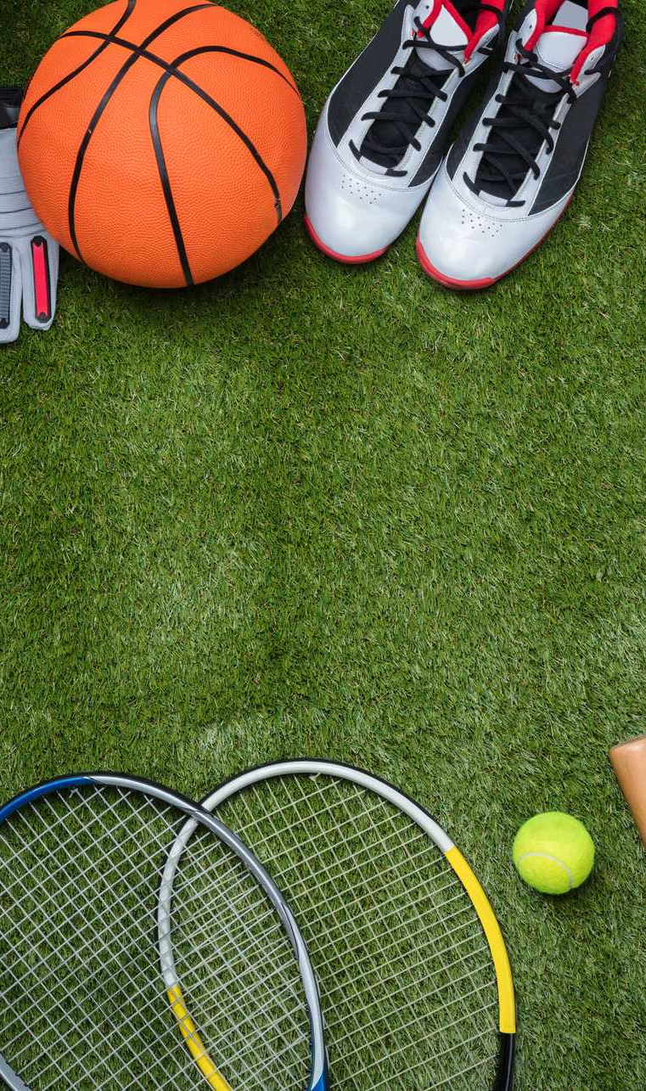

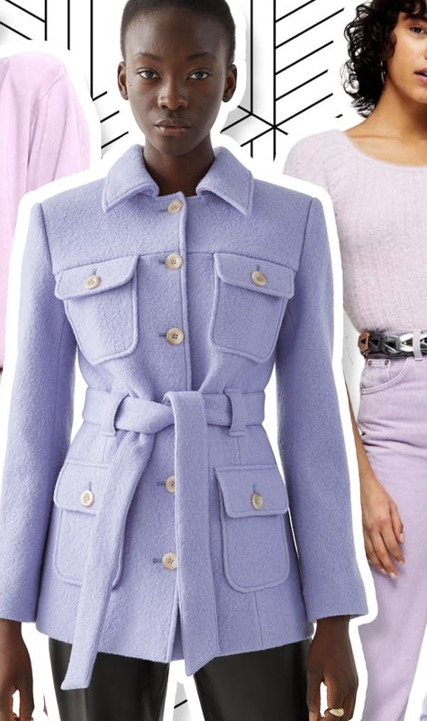
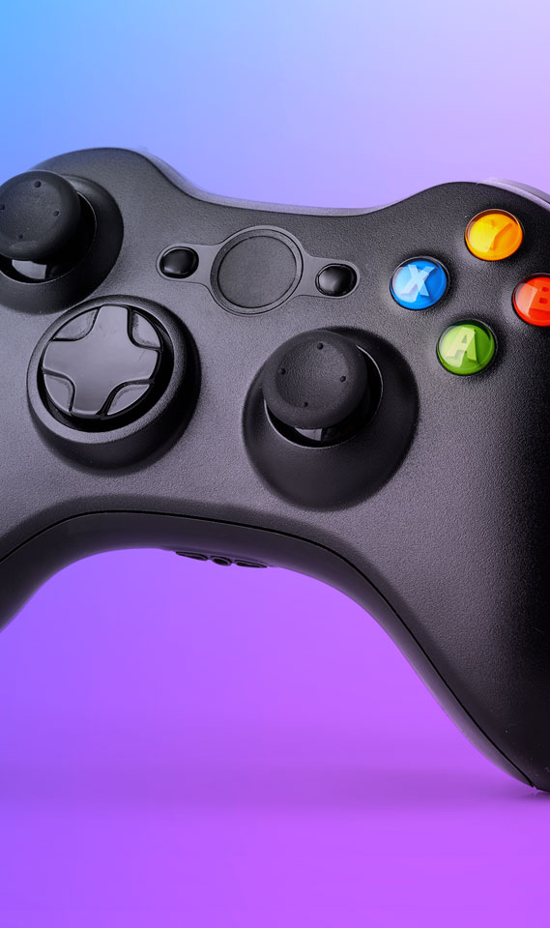
Content
Chat section- live- 2 hosts 1 guest
Gossip section- pre recorded- Gracie
Music- chart rundown- pre recorded- Jakub
Fashion- current trends- live- Jakub and Gracie
Sports- pre recorded- Jakub
Hard hitting section- live- Jakub and Gracie
Gaming section- live- Jakub, Gracie and aleyna
Total of 3 ad breaks- 3 and a half minutes each
Consistent social media involvement throughout

Slide 4
Target audience
Primary and secondary-
Morals- Low, lack of fine taste, consumer culture
Race/religion- more religious people would not watch, whereas atheists might be more likely
Relationship- singles and new couples who will probably be short term or dysfunctional
Geographic's- UK cities
Uni accommodations
Small and affordable homes that still look nice due to image obsession
Primary- 16-25 year olds
Males and females
Class c2-e
Minimum wage jobs
Secondary- 26-35 year olds
Males and females
Class c2-e

Slide 5
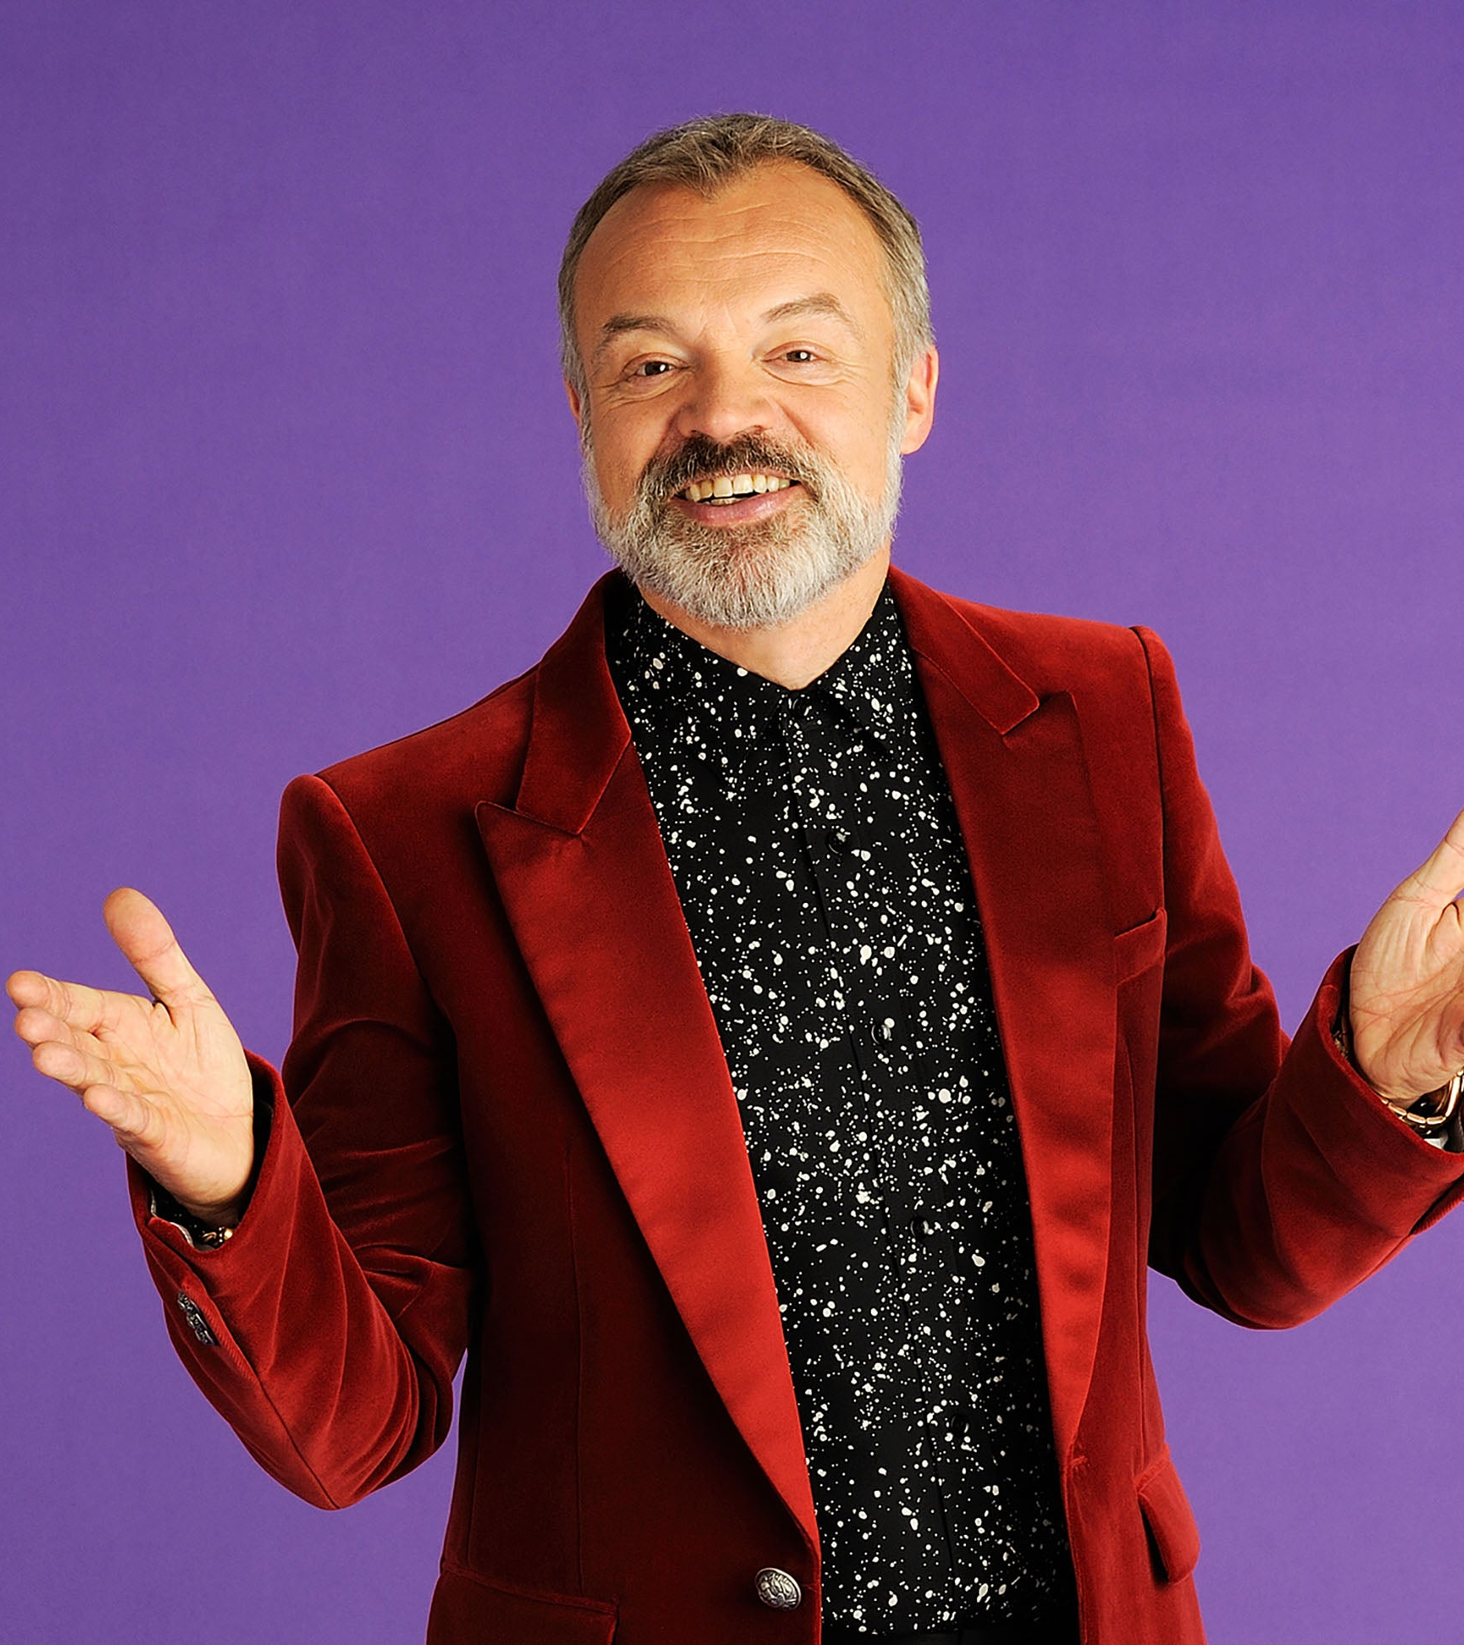

Presenter 1 and graphic designer- Jakub
As PRESENTER 1, I WILL BE one of the faces of the show, meaning that I need to be entertaining, as the host is one of the most important parts. We make up the brand of the show and help draw in an audience.
I will maintain an informal presenting style so that the show does not seem serious, as this will allow me to reach the young target audience and keep the mood upbeat
I will also be producing graphics for the show wherever they may be needed, so I must also think about design techniques

Slide 6
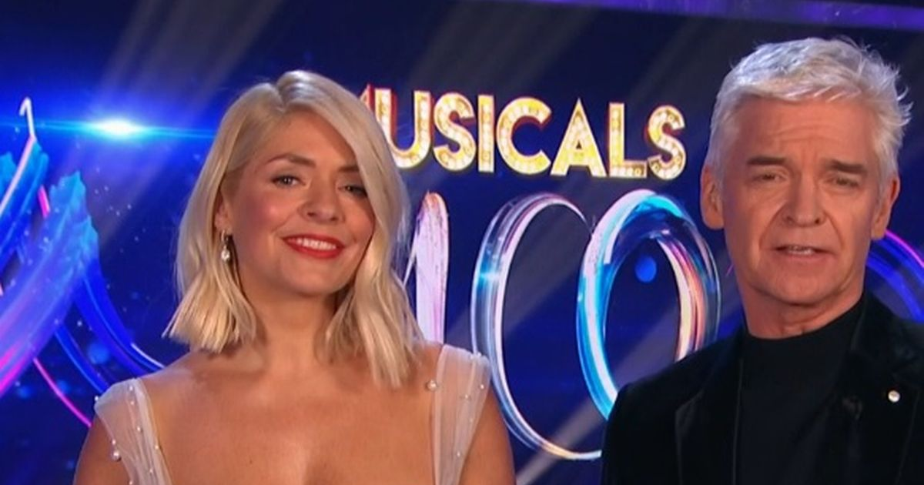
Presenter 2- Gracie
Within this role hypothetically I'm the face of the show with my other fellow presenters. I will be presenting what the directors want us to show and tell to the audience. My job is to entertain and inform an audience. Together we bring the show to life and give the show character.
As a group we have collectively chosen 7 categories to talk about. My chosen topic I will individually be talking about is the gossip section, I feel like as a female talking about the latest gossip I will have a strong lead. Me and my co-presenter Kuba will be talking about. Gaming, serious issues, fashion -men and women’s and social media.
Skills needed to be a presenter-
Skills
• excellent communication and presentation skills.
• performance skills and a clear voice.
• the ability to generate original ideas.
• a personable and confident manner.
• a broad range of interests, including current affairs.
• good research and interviewing skills.
• the confidence and the ability to sell yourself.

Slide 7
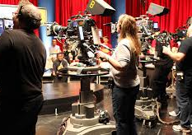
Camera ops
Camera 1- kacper- My job is that of a camera operator as camera 1.
I will have to be able to reposition cameras on the go as well as maintain a flawless recording as well as maintaining my position of the left side as camera 1.
any shots or camera changes are all up to the director up in the gallery. If need be I will communicate with gallery via my floor manager who will rely my request
I have a silent role.
Camera 2- shamaim- My job in the live production is to listen to the director and follow his directors on how he wants the shot to be. My responsibility is that I have to make sure that all the shots are up to industry standards and that the shots are good with the director. I will be placed in the middle of the room meaning that I have to shoot both the presenters. I will be using a headset to listen to the director but my role is a quiet one as I listen and do what I am told.
Camera 3- Jubiair- my role is to record the third camera angle which is mainly on kuba, also my job is to make sure that if anyone needs me to get anything for example a spare battery, I would get it because I am also the runner.

Slide 8
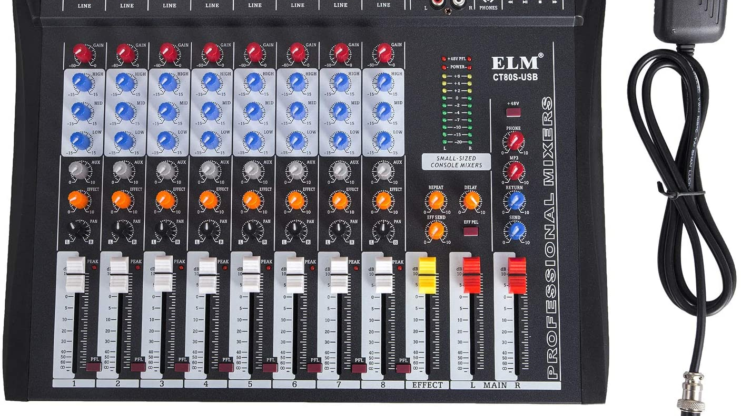
Sound- Esther
I am the sound mixer for this unit. As the sound mixer I will be controlling the volume for the show. I will be sourcing the different sound effects and music for the show. I will also make sure that all the sound equipment works perfectly and that I can hear them clearly. I will be based in the gallery.

Slide 9
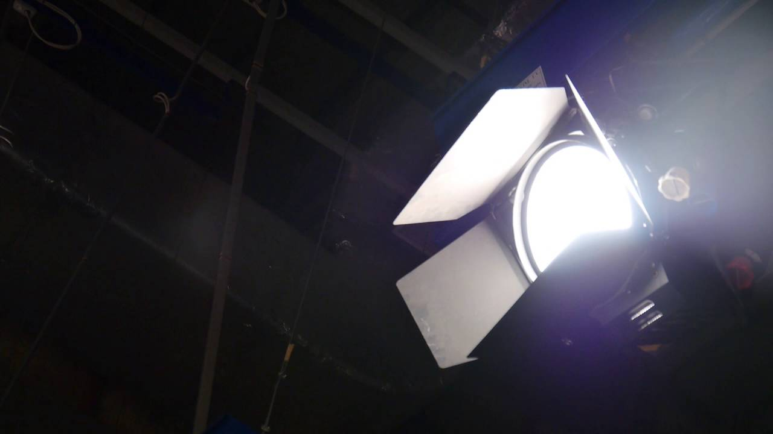
Lighting- Kelsi
I have been assigned the role of lighting technician.
This means that my responsibilities will include making sure the set is lit appropriately so that the presenters are not over exposed as well as ensuring that there are no unwanted shadows cast on set.
I will be based in both the studio and the gallery.
In the studio, I will have to constantly be changing the positions of the LED panel lights so that the three-point lighting is correct in each segment.
In the gallery, I will be in charge of the studio lights and adding in any fade-ins or fade-outs when necessary.
I will be taking orders from the director and I will also be working closely with the camera crew to ensure that the lighting looks good on camera from all angles.

Slide 10
Floor manager- Nikola
As a floor manager, I will need to make sure that I listen to the directions of the director such as, if the director will be telling me that we are about to go on an ad break, I'd have to show the hosts to either speed up what they’re saying as they have a limited amount of time to say it or if they are about to finish the segment before time I'd have to show them that they need to stretch it out so that they won’t be sat there in silence.

Slide 11
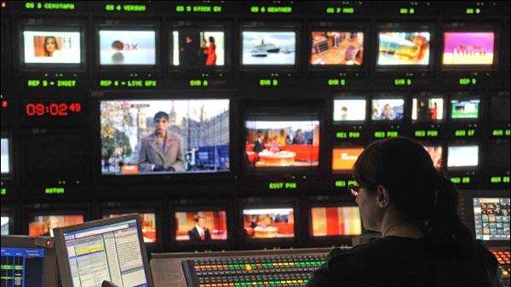
Vision mixer- Chloe
My role in our production is the vision mixer.
The vision mixer live edits the production as its recording. I am in control of what the public sees and I make sure the camera shots move smoothly. Also, the director tells me what camera shots to change to and I make sure the edit runs smoothly. For my role, I stay in the gallery, watching the screens whilst listening to the producer and the director.

Slide 12
Set design, props and costumes- Aleyna
I am the set design and also the prop and costume designer. I am in charge of getting all of the props and costumes for the magazine show. I will also be in charge of the set design. This means that I am in charge of what the set looks like and, to also to get everything to make the set. I have the background colours for our game show to be blue and purple. This is because in our meeting we all discussed and late night chat shows usually go for darker colours and purple is really popular. It was between blue, purple and red and I chose blue and purple for the final decision for the background.

Slide 13
Contingency plan
A lot can go wrong in live productions
We will keep the cameras plugged into the mains so the battery does not run out
We have 2 presenters who can cover for each other if one of them forgets their lines
There are 3 cameras rolling at once, so if one camera messes up or has a poor angle, we can switch to the other cameras

Slide 14

Budget
£120- £10 per person

Slide 15
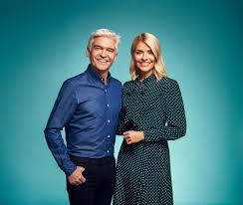

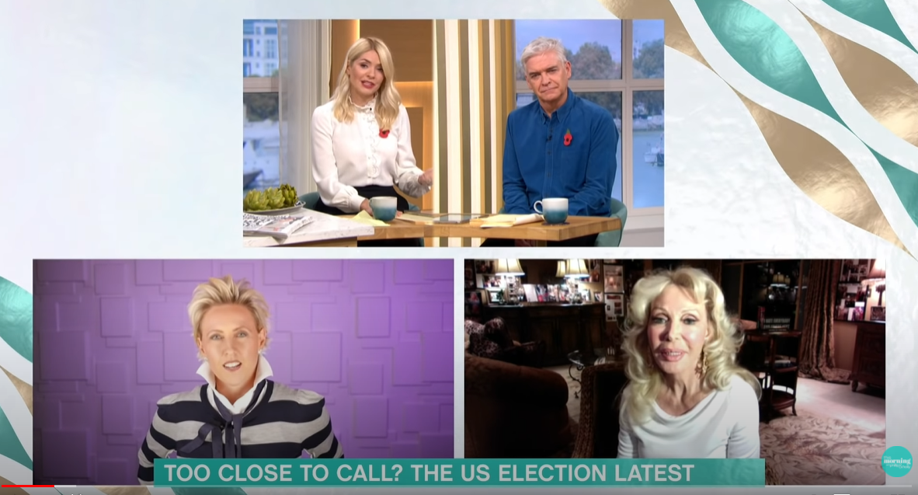
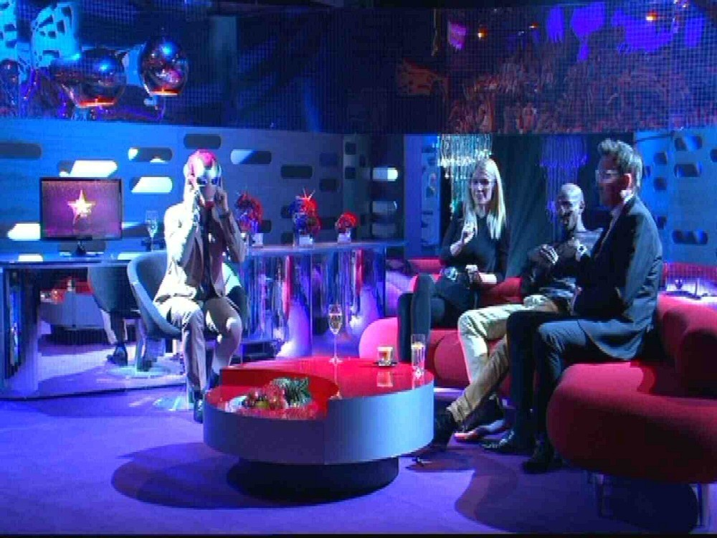

Mood board
https://www.youtube.com/watch?reload=9&v=TOfR3H5W_jk

