Slide 1
# RUSH HOUR
SHAMIAM, ESTHER AND ZOE

Slide 2
Introduction
Esther Stephenson - Presenter 1
Shamiam Arif - Presenter 2
Zoe White - Producer
Hello welcome to our pitch, today we will pitch our radio product to you called rush hour. This is will be a Drive Time Radio show and we hope that you all we like the idea that we came up with.

Slide 3
Presenters names & Presenter style
We decided that we are going to keep our names the same because we thought that it would be original and different.
We decided that Shamiam and I are going to be the presenters because we are bubbly, funny and energetic
The presenter style that we came up with was that it was going to be:
  Energetic because we want those who are going off to work or going out to have energy.
  Relaxing and calming because those who have had a stressful day would just want to relax and calm down and not think about what caused them to be stressed.
  Informal language because we said that we wanted to create something that they would understand.
  Comedy because everyone likes a good laugh and if people have had a bad day a laugh can brighten their day

Slide 4
The demands of the Barnfield remit
The barnfield remit says that our radio show must contain these things:
  A distinctive mix of contemporary music and speech. Speech to music ratio is 70% to 30% for all shows.
  They must be high quality, original, innovative and engaging, expose listeners to new and sometimes challenging material, it should reflect a diverse range of new and UK
  offer a mix of music,news, information and entertainment relevant to their schedule. The schedule for the entire day should be outlined so audiences know what is up Programmes should encourage its listeners to take part in local activities. . Adverts must be played every 15 minutes for a maximum of 30 seconds.
  Its target audience is 16-21 year olds and it should also provide some programming for younger teenagers (13-15.)

Slide 5
Meeting the target audience needs
We decided that we are going to have third target audiences:
  Primary audience : 16 to 21 year old
  Secondary audiences: 13 to 15 year old
  Tertiary audiences: 21 and older
For Primary audiences, we will be talking about the social awareness topic (mental health) as we think that this will touches the audiences.
For the secondary audiences, in one of your topics (film and TV) we are going to talking about a film under the age of 15 so they can watch it in the cinema
For the tertiary audiences, we will be talking about the news and this interesting for this audiences.

Slide 6
Station and program content
The content that will be on the radio show is:
  The topics: Film and TV, Gossip, Debate, Entertainment
The social awareness topic is:
  Mental health: types, facts, how to look after yourself and to get help from others
There will be two segment of new: short bullies and long stories
For the Film and TV we will be talking about our favorite shows/film and making reviews on the upcoming film
For the Gossip we will be talking about celebrities, awards,
For the debate we will be talking about knife crime and how they affect us as young people and we will go into more detail about.

Slide 7
Outline your running order
At the beginning we are going to play the station ident and then it is going into the topic of entertainment.
After entertainment we thought that we can do a competition that is a quiz of trivia questions and throughout the show we are going to have calls in at different points during the show.
After the competition we thought that we could go into film and tv
After talking about film and Tv we are going to go into our social awareness topic.
We said that we wanted to go into a debate of knife crime.
At the end we said we can end on celebrity gossip.

Slide 8
Outline your running Order
Each topic will last 5- 10 minutes long.
We will place the first news bulletin 15 minutes into the show it will last 30 seconds long. The second news bulletin will be 45 minutes into the show, it will last for 1 minute.
The adverts will play every 15 minutes they will last 30 seconds long.
Music will be played in different areas of the show.

Slide 9
Program and Station idents
Idents are going to have upbeat and happy music as it will play when people are driving home and to school this will cheer them up
We will add idents about the Competitions and the news and our social awareness so audience knows what is going on in the show.
We also have some at the start so people know what radio station is, and have this indent after the songs so the listeners always know what the radio is.

Slide 10
Production requirements
We will not be needing any guests.
We will be using sound effects and we will be sourcing these from youtube.
We are going to download an app that changes into different voices
The music that we need will be sourced from youtube

Slide 11
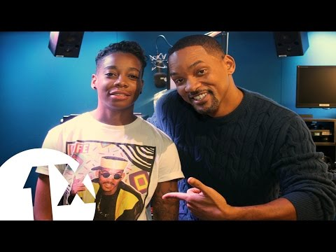


Mood board
Will Smith talks 'Bad Boys 3' and 'Parenting' with A.Dot
Unpopular opinions with niall horan

Slide 12
Thank you for listening
&
Any questions

